Slide 1
Chapter 2 Architecture of a Search Engine
SEG301m

Slide 2
Objectives
Basic IR System Architecture
Basic blocks inside search engine
How to rank a website and evaluate search engine

Slide 3
Contents
2.1 Basic IR System Architecture
2.2 Building blocks:
Text acquisition
Text transformation
Index Creation
User Interaction
Ranking
Evaluation

Slide 4
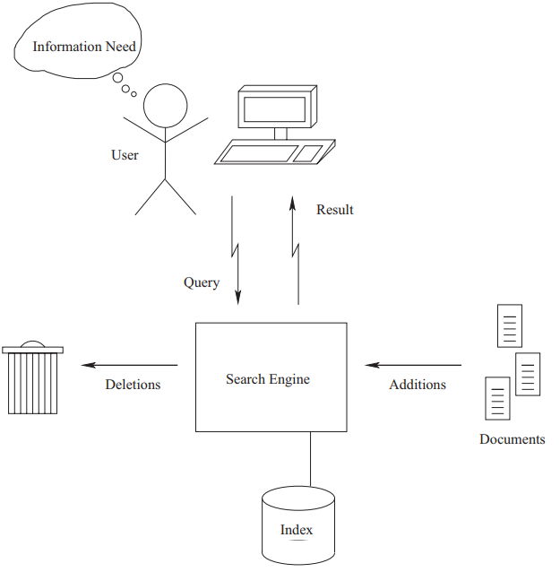
2.1 Basic IR System Architecture
Components in information retrieval system
A user has an information need, which underlies and drives the search process
User constructs and issues a query to the IR system
Search engine is to maintain and manipulate an inverted index for a document collection
Index provides a mapping between terms and the locations in the collection in which they occur

Slide 5
2.1 Basic IR System Architecture
Search engine has played an important role in IR system. Its primary goals include:
Effectiveness (quality): retrieve the most relevant set of documents possible for a query
Efficiency (speed): process queries from users as quickly as possible

Slide 6
2.1 Basic IR System Architecture
Search engine has two major components
Indexing process
Query process

Slide 7
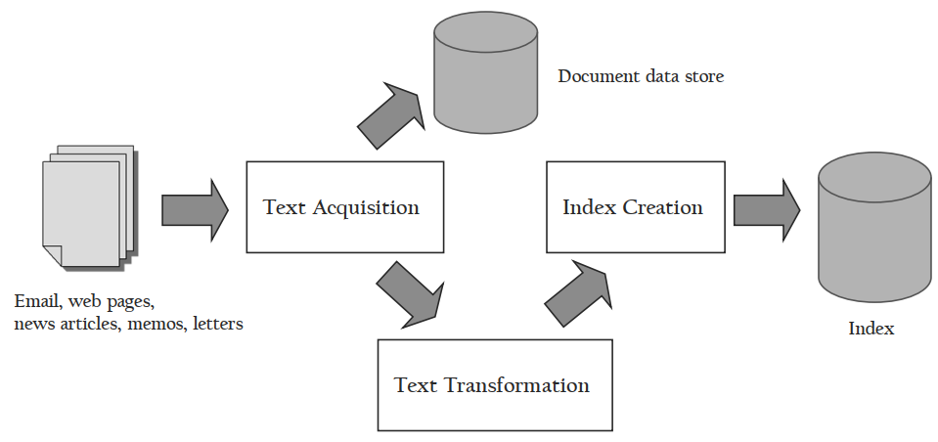
2.1 Basic IR System Architecture
Search engine: Indexing process

Slide 8
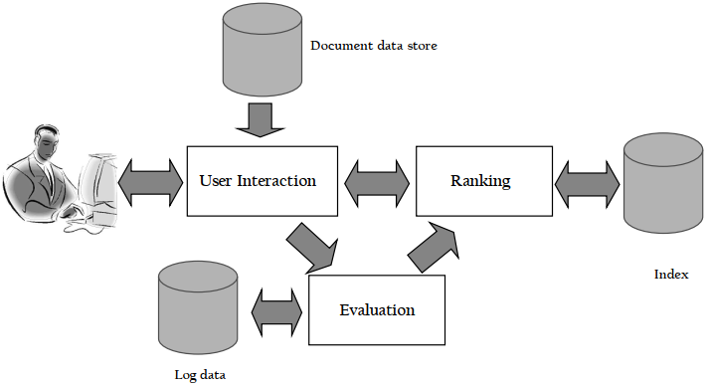
2.1 Basic IR System Architecture
Search engine: Query process

Slide 9
2.2 Building blocks
Text acquisition
Text transformation
Index Creation
User Interaction
Ranking
Evaluation

Slide 10
2.2 Building blocks: Text acquisition
Task: identify and make available the documents that will be searched
Crawler
Feeds
Conversion
Document data store

Slide 11
2.2 Building blocks: Text acquisition
General web crawler
Follow the links on web pages to discover and download new pages
Efficiently find huge numbers of web pages (coverage) and keep them up-to-date (freshness)
Single site crawlers for site search
Topical or focused crawlers for vertical search
Document crawlers for enterprise and desktop search
Follow links and scan directories

Slide 12
2.2 Building blocks: Text acquisition
Feeds
Mechanism for accessing a real-time stream of documents
News feed is a constant stream of news stories and updates
A search engine acquires new documents from a feed simply by monitoring it
RSS is a common standard used for web feeds for content such as news, blogs, or video
Conversion
Convert documents into a consistent text plus metadata format
HTML, XML, PDF, Word, … → XML
Convert text encoding for different languages
8-bit ASCII code represents 256 characters, Chinese have many more than 256 characters → cannot by represented 8-bit ASCII
Unicode (16-bit words) represent most of the world’s languages

Slide 13
2.2 Building blocks: Text acquisition
Document data store
Database used to manage large numbers of documents and the structured data that is associated with them
Stores text, metadata and other related content (links or anchor text) for documents
Provides very fast access to document contents for search engine components
Can use a relational database system to store documents and metadata
Use a simpler, more efficient storage system is used because of huge numbers of documents

Slide 14
2.2 Building blocks
Text acquisition
Text transformation
Index Creation
User Interaction
Ranking
Evaluation

Slide 15
2.2 Building blocks: Text transformation
Parser
Processing the sequence of text tokens in the document to recognize structural elements
e.g., titles, links, headings, etc.
Tokenizer recognizes “words” in the text
Must consider issues like capitalization, hyphens, apostrophes, non-alpha characters, separators
Markup languages such as HTML, XML often used to specify structure
Tags used to specify document elements: E.g. <h/2> Overview <h/2>
Document parser uses syntax of markup language (or other formatting) to identify structure

Slide 16
2.2 Building blocks: Text transformation
Stopping
Remove common words
e.g., “and”, “or”, “the”, “in”
Some impact on efficiency and effectiveness
Can be a problem for some queries
Stemming
Group words derived from a common stem
e.g., “computer”, “computers”, “computing”, “compute”
Usually effective, but not for all queries
Benefits vary for different languages

Slide 17
2.2 Building blocks: Text transformation
Link extraction and analysis
Makes use of links and anchor text in web pages
Link analysis identifies popularity and community information
e.g., PageRank, Hubs & Authorities
Anchor text can significantly enhance the representation of pages pointed to by links
Significant impact on web search
Less importance in other applications

Slide 18
2.2 Building blocks: Text transformation
Information Extraction
Identify classes of index terms that are important for some applications
e.g., named entity recognizers identify classes such as people, locations, companies, dates, etc.
Classifier
Identifies class-related metadata for documents
i.e., assigns labels to documents (identifying documents as spam, and identifying the non-content parts of documents, such as advertising)
e.g., topics (“sports”, “politics”, or “business”), reading levels, sentiment, genre
Use depends on application

Slide 19
2.2 Building blocks
Text acquisition
Text transformation
Index Creation
User Interaction
Ranking
Evaluation

Slide 20
2.2 Building blocks: Index Creation
Document Statistics
Gathers counts and positions of words and other features
Ranking algorithm uses to compute doc scores
Weighting
Computes weights for index terms
Used in ranking algorithm
e.g., tf.idf weight
Combination of term frequency in document and inverse document frequency in the collection

Slide 21
2.2 Building blocks: Index Creation
Inversion
Core of indexing process
Converts document-term information to term-document for indexing
Difficult for very large numbers of documents
Format of inverted file is designed for fast query processing
Must also handle updates
Compression used for efficiency

Slide 22
2.2 Building blocks: Index Creation
Index Distribution
Distributes indexes across multiple computers and/or multiple sites on a network
Essential for fast query processing with large numbers of documents
Many variations
Document distribution, term distribution, replication
P2P and distributed IR involve search across multiple sites

Slide 23
2.2 Building blocks
Text acquisition
Text transformation
Index Creation
User Interaction
Ranking
Evaluation

Slide 24
2.2 Building blocks: User Interaction
Query input
Provides interface and parser for query language
Most web queries are very simple (few operators), other applications may use forms
Query language used to describe more complex queries and results of query transformation
e.g., Boolean queries, Indri and Galago query languages
Similar to SQL language used in database applications
IR query languages also allow content and structure specifications, but focus on content

Slide 25
2.2 Building blocks: User Interaction
Query transformation
Improves initial query, both before and after initial search
Includes text transformation techniques used for documents (e.g. tokenization, stopping)
Spell checking and query suggestion provide alternatives to original query
Query expansion and relevance feedback modify the original query with additional terms

Slide 26
2.2 Building blocks: User Interaction
Results output
Constructs the display of ranked documents for a query
Generates snippets to show how queries match documents
Highlights important words and passages
Retrieves appropriate advertising in many applications
May provide clustering and other visualization tools

Slide 27
2.2 Building blocks
Text acquisition
Text transformation
Index Creation
User Interaction
Ranking
Evaluation

Slide 28
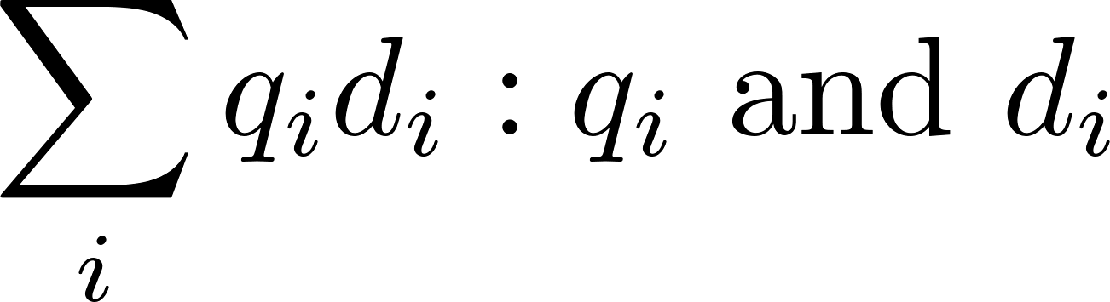
2.2 Building blocks: Ranking
Scoring
Calculates scores for documents using a ranking algorithm
Core component of search engine
Basic form of score is are query and document term weights for term i
Many variations of ranking algorithms and retrieval models

Slide 29
2.2 Building blocks: Ranking
Performance optimization
Designing ranking algorithms for efficient processing
Term-at-a time vs. document-at-a-time processing
Safe vs. unsafe optimizations
Distribution
Processing queries in a distributed environment
Query broker distributes queries and assembles results
Caching is a form of distributed searching

Slide 30
2.2 Building blocks
Text acquisition
Text transformation
Index Creation
User Interaction
Ranking
Evaluation

Slide 31
2.2 Building blocks: Evaluation
Logging
Logging user queries and interaction is crucial for improving search effectiveness and efficiency
Query logs and click-through data or dwell time used for query suggestion, spell checking, query caching, ranking, advertising search, and other components
Ranking analysis
Measuring and tuning ranking effectiveness
Performance analysis
Measuring and tuning system efficiency

Slide 32
Exercise
Find some examples of the search engine components described in this chapter in the Galago code.

Slide 33
Exercise
Obtain and install an open-source IR system. Create a small document collection from your e-mail, or from another source. A few dozen documents should be enough. Index your collection. Try a few queries.
Notes:
Imformation retrieval implementing and evaluating search engine: Section 1.5

Slide 34
Summary
Components in information retrieval system: information need, user, IR system, Search engine, Index
Primary goals as designing search engines: effectiveness and efficiency
Building blocks: Text acquisition, Text transformation, Index Creation, User Interaction, Ranking, Evaluation

